Slide 1
Electronic Voting Machine using Arduino
Table of Contents:
Introduction
Circuit Diagram
Working
Need and Application
Conclusion By Tejas Shinde 23EEB0A43
Taksheel Dupare 23EEB0A59
Ajwad Habib Anwer Sadath 23EEB0F04

Slide 2
Introduction
An Electronic Voting Machine (EVM) is a device used to electronically record and count votes in elections. It a device for secure, fast, and accurate voting.
This project demonstrates a simplified EVM using Arduino, showcasing how electronics can modernize traditional voting systems.
Why Arduino?
Arduino is open-source, easy to program, and ideal for prototyping.
Instant vote counting – No manual tallying errors.
Real-time LCD display – Shows live results.
Standalone system – No Wi-Fi/Bluetooth means no remote hacking risk.
Tamper-resistant – Votes stored locally (unlike online voting systems).

Slide 3
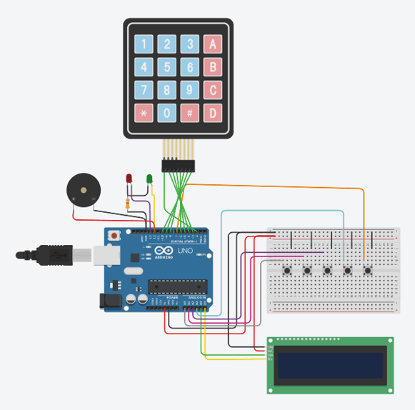
Components Required
Arduino Uno Board: Circuit board containing the microcontroller that processes inputs and controls outputs and software IDE for programming it.
LCD 16x2 I2C: A device that can display text and characters on a 16x2 liquid crystal display (LCD) using the I2C protocol. For displaying voting options and results.
Push Buttons: Used for casting votes.
Resistors: For current limiting and pull-down configurations.
Breadboard: For prototyping the circuit.
Jumper Wires: For connections between components.
LEDs: Lights up when a vote is successful and while displaying results.
Piezo : Acts as a buzzer when voting.
Keypad 4x4: Used to type identification code.

Slide 4
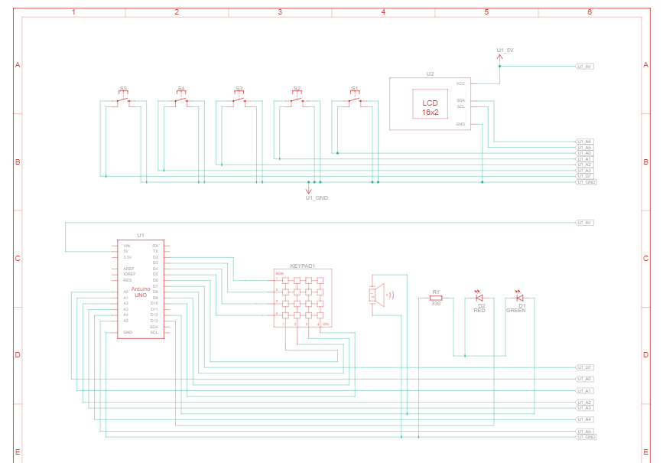
Circuit Diagram
Connections:
The circuit diagram illustrates how components are connected.
Arduino Uno Connections:
Power and Ground:
VIN: Connected to the 5V power supply.
GND: Connected to the ground rail.
Digital Pins:
D2-D5: Connected to the keypad's column pins (C1-C4).
D6-D9: Connected to the keypad's row pins (R1-R4).
D10: Connected to the buzzer.
D11: Connected to the green LED (via resistor R1).
D12: Connected to the red LED.
Notes:
Push Button : A pushbutton contains metal contacts that are squished together when the button is pressed, allowing electrical current to flow. This pushbutton has four wire leads, two sets of which are internally connected always, and the two sets touch when the button is pressed.
Arduino Uno R3 : This device has an ATMega328 microcontroller, six analog inputs, and 13 digital input/outputs. Piezo: Piezos can convert alternating electrical current into sound (vibration), and vice versa. Keypad 4*4: Patterns of conductive material are printed onto layers of plastic, and a small domed membrane can be squeezed or pressed to allow contact between the two surfaces. LED: LEDs are made from semiconductor materials that emit light when current flows through them in the correct direction. Too much current can damage or break them, so add a resistor in series to limit the current flow.

Slide 5
Analog Pins:
A0-A4: Connected to push buttons F1-F5.
A5 (SDA) and A4 (SCL): Connected to the LCD module for I2C communication.
2. Push Button Connections:
F1-F5:
One terminal connected to analog pins A0, A1, A2, A3, and A4 respectively.
Other terminal connected to ground.
3. Key Pad Connections:
The keypad has 4 rows and 4 columns:
Rows (R1-R4):
Connected to digital pins D6, D7, D8, and D9 on the Arduino.
Columns (C1-C4):
Connected to digital pins D2, D3, D4, and D5 on the Arduino.
4. LCD Connections:
VCC: Connected to the 5V power supply.
GND: Connected to ground.
SDA: Connected to A5 on the Arduino.
SCL: Connected to A4 on the Arduino.
Notes:
Didn’t have space to write this ,also not that imp but other connections are:
Buzzer Connection
One terminal of the buzzer is connected to digital pin D12 on the Arduino.
The other terminal is connected to ground.
6. LED Connections
Green LED:
Positive terminal connected to digital pin D12
Negative terminal connected to ground via resistor of 330 ohms
Red LED:
Positive terminal connected to digital pin D13
Negative terminal connected to ground via resistor of 330 ohms

Slide 6
Working
The EVM system functions as follows:
User Authentication: The system first prompts the user to enter their roll number using the keypad. This number is checked against a pre-defined database. If the roll number is valid and the user hasn't voted yet, they are authenticated.
Voting: Once authenticated, the user is presented with the voting screen. They can then cast their vote for one of four candidates by pressing the corresponding button.
Vote Recording: The vote is recorded, and the user is marked as having voted to prevent multiple votes.
Results Display: Pressing the result button (SW5) displays the election results on the LCD, indicating the candidate with the most votes. After a delay, the system resets and returns to the login prompt.
Hardware components:
Arduino UNO: The microcontroller acts as the brain of the EVM, controlling the LCD, keypad, buttons, LEDs, and buzzer.
LCD (16x2): Displays prompts, user names, voting options, results, and system messages. It communicates with the Arduino via I2C.
Keypad (4x4 Matrix): Used for entering the roll number for authentication. Rows are connected to D6-D9 and columns to D2-D5 on the Arduino.
Push Buttons (5):
Four buttons (SW1-SW4 connected to A0-A3) represent the four candidates (A, B, C, and OTH).
One button (SW5 connected to D7) is used to display results.
Green LED (D12): Indicates a successful vote.
Red LED (D13): Indicates that results are being displayed.
Buzzer (D12): Rings while pressing the push button .
Pull-up Resistors: The code configures the button input pins (A0-A3) to use internal pull-up resistors. When a button is pressed, the corresponding pin is pulled LOW.

Slide 7
Software Logic:
#include <Adafruit_LiquidCrystal.h>: Includes the library to control the LCD.
#include <Keypad.h>: Includes the library to handle the keypad input
Setup:
pinMode(sw1, INPUT); ... pinMode(sw5, INPUT);: Configures the button pins as inputs.
digitalWrite(sw1, HIGH); ... digitalWrite(sw5, HIGH);: Enables the internal pull-up resistors for the button input pins.
pinMode(12, OUTPUT); pinMode(13, OUTPUT);: Configures the LED pins as outputs.
lcd_1.begin(16, 2);: Initializes the LCD with 16 columns and 2 rows. Again, this will need to be changed depending on your LCD type.
promptForLogin();: Displays the initial login prompt on the LCD.
Loop:
The loop() function continuously checks for the result button press (SW5). If pressed, the showResults() function is called.
If not authenticated, it calls handleLogin() to process keypad input.
If authenticated, it calls handleVoting() to process voting button input, but only displays the voting screen once.
Authentication (handleLogin(), authenticateUser()):
handleLogin(): Reads the keypad input and appends the digits to the inputRoll string.
authenticateUser(): Converts the entered roll number to an integer and checks it against the rollNumbers array. If a match is found and the user hasn't voted, the user is authenticated.
Notes:
Again not enough space just read this continuation if necessary
Voting (handleVoting(), recordVote()):
handleVoting(): Checks which voting button is pressed (SW1-SW4).
recordVote(): Increments the corresponding vote counter and marks the user as having voted. It also displays a "Vote recorded" message and returns to the login screen.
Results Display (showResults()):
showResults(): Called when the result button is pressed. It determines the winner based on the vote counts and displays the result on the LCD. It then resets the vote counters, voting status of all users, and returns to the login screen.

Slide 8
Advantages
Advantages of Electronic Voting Machines:
Cost-Effectiveness: Utilizes low-cost components (Arduino, LCD, keypad).
Simplicity and Ease of Use: User-friendly interface, minimal training required.
Transparency and Accuracy: Real-time vote counting, reduces manual errors.
Efficiency: Faster voting and result declaration compared to traditional methods.
Eliminates issues with paper ballot interpretation
Environmental Friendliness: Reduces paper usage and waste.
Adaptability: Can be customized with additional features like biometric authentication.
Notes:
Add some image here?

